Slide 1
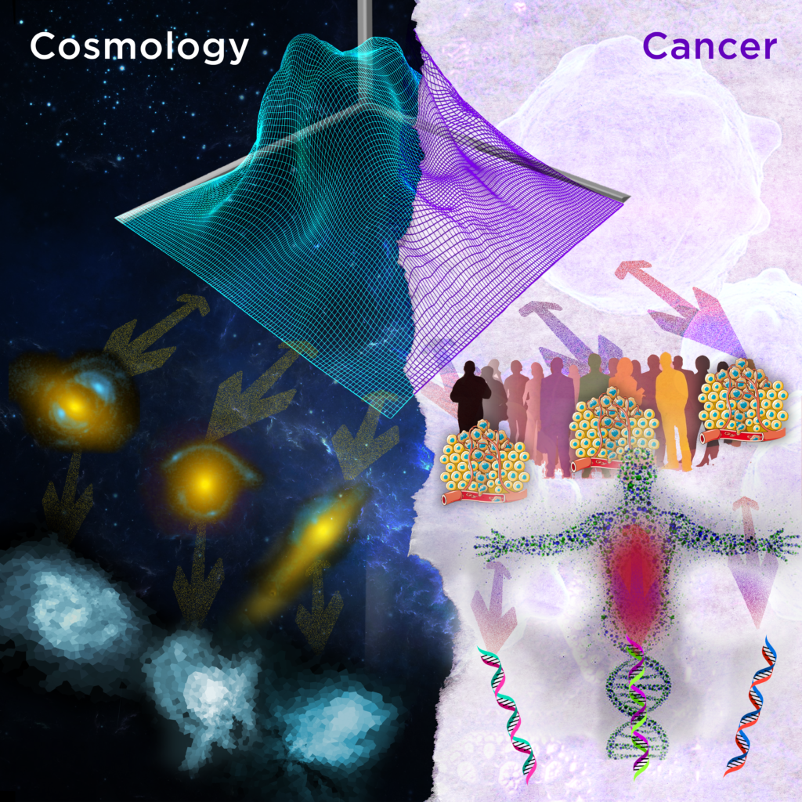

PyAutoFit: Classy Probabilistic Programming for Data Science
James Nightingale Richard Hayes, Matthew Griffiths
www.jamesnightingale.net

Slide 2
Overview
PyAutoFit & Probabilistic Programming:
What is probabilistic programming?
What is PyAutoFit?
Why PyAutoFit?
Cosmology:
Description of example use-case - strong gravitational lensing.
Application to Astronomy data.
Building multi-level models via Python classes.

Slide 3
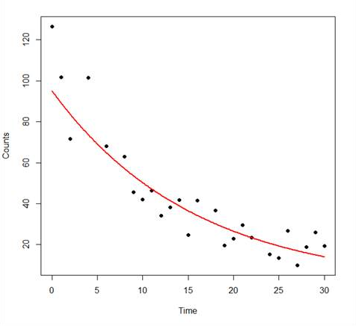
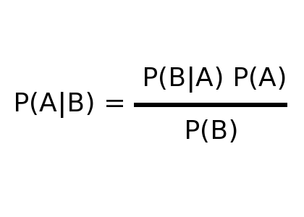
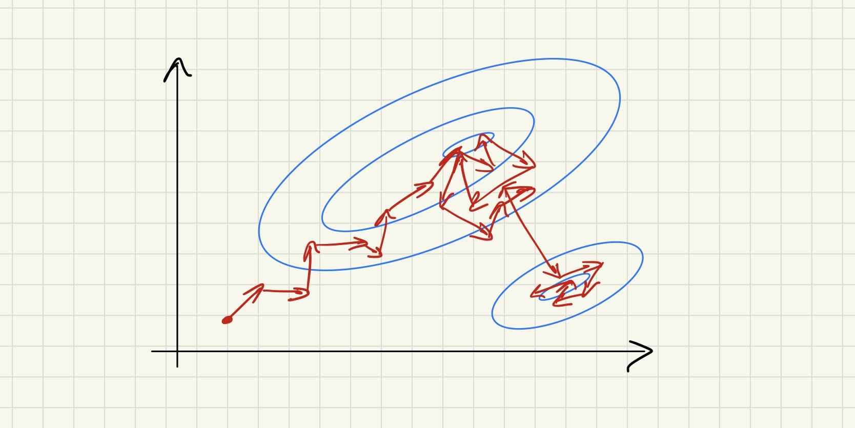
Model Fitting
Given some data and a model, finding the set of model parameters that provide the best fit to the data.

Slide 4
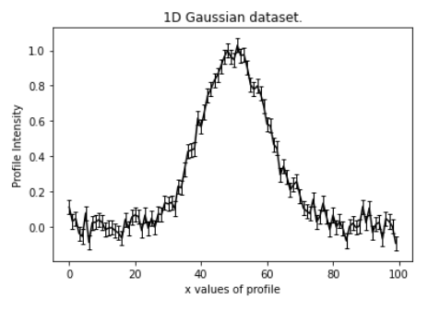
Model Fitting
Model -> Gaussian:
Centre
Normalization
Sigma
Draw a set of parameters.
Create Model Gaussian.
Fit to Dataset.
Compute Likelihood.
Repeat using non-linear search.

Slide 5
Model Fitting
Model -> Gaussian:
Centre = 60.0
Intensity = 20.0
Sigma = 15.0
Draw a set of parameters.
Create Model Gaussian.
Fit to Dataset.
Compute Likelihood.
Repeat using non-linear search.

Slide 6
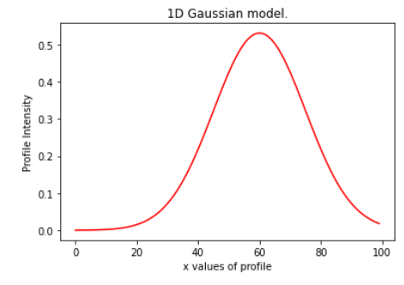
Model Fitting
Model -> Gaussian:
Centre = 60.0
Intensity = 20.0
Sigma = 15.0
Draw a set of parameters.
Create Model Gaussian.
Fit to Dataset.
Compute Likelihood.
Repeat using non-linear search.

Slide 7
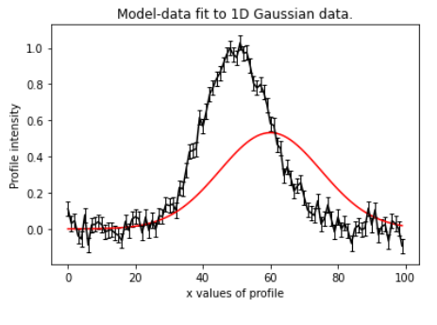
Model Fitting
Model -> Gaussian:
Centre = 60.0
Intensity = 20.0
Sigma = 15.0
Draw a set of parameters.
Create Model Gaussian.
Fit to Dataset.
Compute Likelihood.
Repeat using non-linear search.

Slide 8
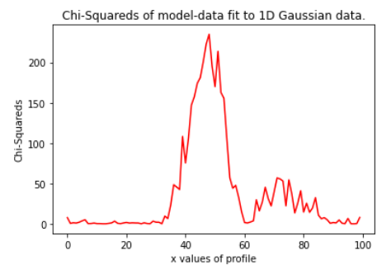
Model Fitting
Model -> Gaussian:
Centre = 60.0
Intensity = 20.0
Sigma = 15.0
Draw a set of parameters.
Create Model Gaussian.
Fit to Dataset.
Compute Likelihood.
Repeat using non-linear search.

Slide 9
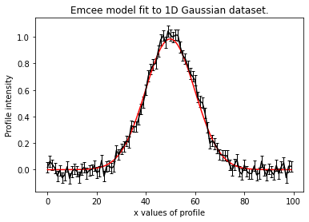
Model Fitting
Model -> Gaussian:
Centre = 50.0
Intensity = 10.0
Sigma = 5.0
Draw a set of parameters.
Create Model Gaussian.
Fit to Dataset.
Compute Likelihood.
Repeat using non-linear search.

Slide 10
Probabilistic Programming

Slide 11
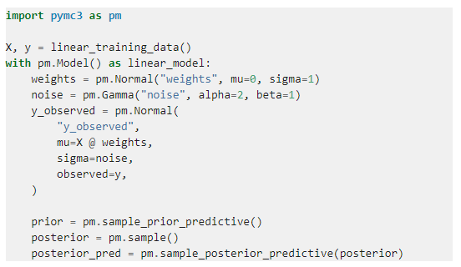
What is Probabilistic Programming?
Probabilistic programming languages (PPL) provide a framework that allows users to easily specify a probabilistic model and perform inference automatically.
There are a plethora of PPL’s available (e.g. PyMC3, STAN, Pyro).
All are suited to different problems, have different core features, etc.
They are some of the Github mega projects, so why on Earth are we developing our own PPL?

Slide 12
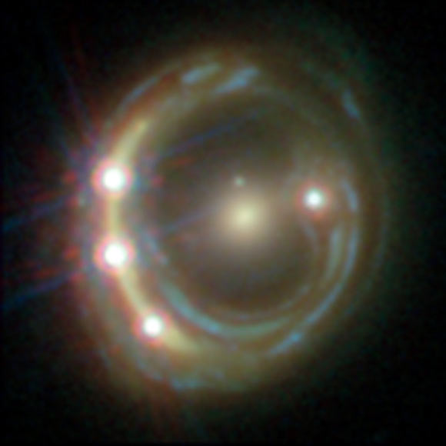
PyAutoFit: A PPL for Astronomers (and data science!)
Existing PPL’s not suited to the model fitting challenges we faced when in Astronomy, for example:

Slide 13
PyAutoFit: A PPL for Astronomers (and data science!)
Existing PPL’s not suited to the model fitting challenges we faced when in Astronomy, for example:
Fitting large and homogenous datasets with an identical model fitting procedure, with tools for processing the large libraries of results output.

Slide 14
PyAutoFit: A PPL for Astronomers (and data science!)
Existing PPL’s not suited to the model fitting challenges we faced when in Astronomy, for example:
Fitting large and homogenous datasets with an identical model fitting procedure, with tools for processing the large libraries of results output.
Problems where likelihood evaluations are expensive (e.g. run times of days per model-fit), necessitating highly customizable model-fitting pipelines with support for massively parallel computing.

Slide 15
PyAutoFit: A PPL for Astronomers (and data science!)
Existing PPL’s not suited to the model fitting challenges we faced when in Astronomy, for example:
Fitting large and homogenous datasets with an identical model fitting procedure, with tools for processing the large libraries of results output.
Problems where likelihood evaluations are expensive (e.g. run times of days per model-fit), necessitating highly customizable model-fitting pipelines with support for massively parallel computing.
Fitting many different models to the same dataset with tools that streamline model comparison.

Slide 16
PyAutoFit: A PPL for Astronomers (and data science!)
Existing PPL’s not suited to the model fitting challenges we faced when in Astronomy, for example:
Fitting large and homogenous datasets with an identical model fitting procedure, with tools for processing the large libraries of results output.
Problems where likelihood evaluations are expensive (e.g. run times of days per model-fit), necessitating highly customizable model-fitting pipelines with support for massively parallel computing.
Fitting many different models to the same dataset with tools that streamline model comparison.
PyAutoFit: highly customizable model-fitting software, for big data challenges in the many model regime.

Slide 17
PyAutoFit: Classy Interface

Slide 18
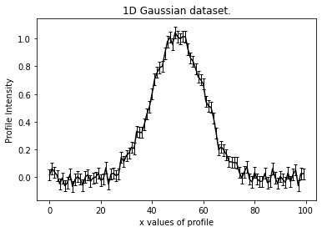
PyAutoFit: Classy Probabilistic Programming
Illustrative example, fitting noisy 1D data of a Gaussian.
Aim: use PyAutoFit to fit a Gaussian to the dataset via a non-linear search.

Slide 19
PyAutoFit: Classy Probabilistic Programming
Illustrative example, fitting noisy 1D data of a Gaussian.
Aim: use PyAutoFit to fit a Gaussian to the dataset via a non-linear search.

Slide 20
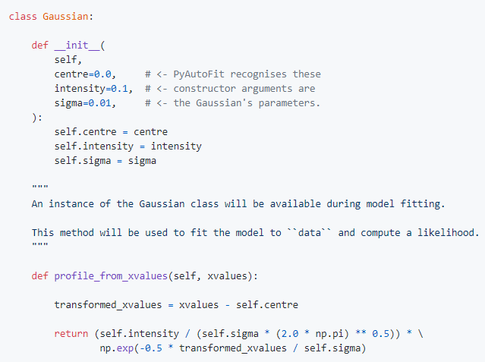
PyAutoFit: Classy Probabilistic Programming
Illustrative example, fitting noisy 1D data of a Gaussian.
Write a Python class to define the model component.

Slide 21
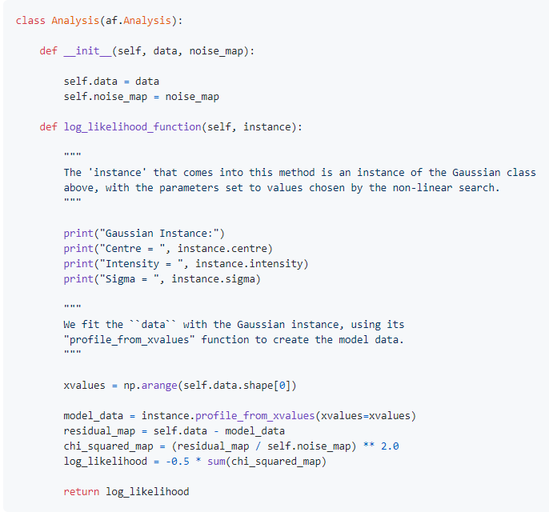
PyAutoFit: Classy Probabilistic Programming
Illustrative example, fitting noisy 1D data of a Gaussian.
Write a Python class to define the model component.
Write an Analysis class with the data and likelihood function.

Slide 22
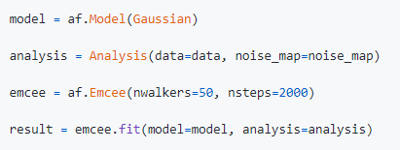
PyAutoFit: Classy Probabilistic Programming
Illustrative example, fitting noisy 1D data of a Gaussian.
Write a Python class to define the model component.
Write an Analysis class with the data and likelihood function.
Combine with your favourite non-linear search to fit the model to the data.

Slide 23
PyAutoFit: Classy Probabilistic Programming
Illustrative example, fitting noisy 1D data of a Gaussian.
Aim: use PyAutoFit to fit a Gaussian to the dataset via a non-linear search.

Slide 24
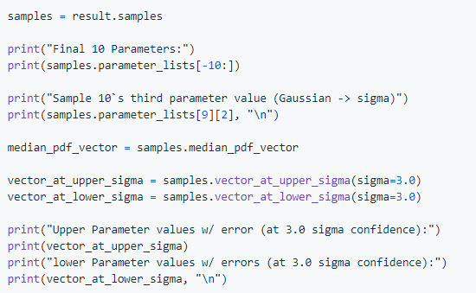
PyAutoFit: Classy Probabilistic Programming
Illustrative example, fitting noisy 1D data of a Gaussian.
Write a Python class to define the model component.
Write an Analysis class with the data and likelihood function.
Combine with your favourite non-linear search to fit the model to the data.
Result object contains all the information you need on your model-fit.

Slide 25
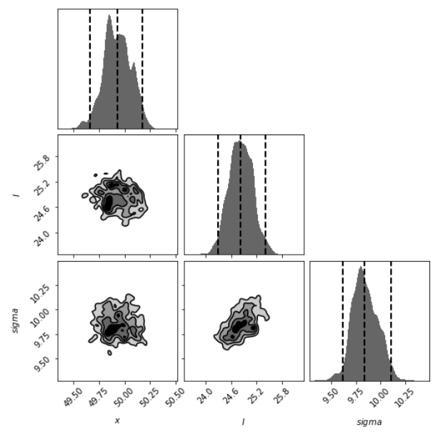
PyAutoFit: Classy Probabilistic Programming
Illustrative example, fitting noisy 1D data of a Gaussian.
Write a Python class to define the model component.
Write an Analysis class with the data and likelihood function.
Combine with your favourite non-linear search to fit the model to the data.
Result object contains all the information you need on your model-fit.

Slide 26
PyAutoFit: Links / Overview

Slide 27
PyAutoFit
GitHub: https://github.com/rhayes777/PyAutoFit
Readthedocs: https://pyautofit.readthedocs.io/en/latest/
JOSS Paper: https://joss.theoj.org/papers/10.21105/joss.02550 Binder: https://mybinder.org/v2/gh/Jammy2211/autofit_workspace/HEAD

Slide 28
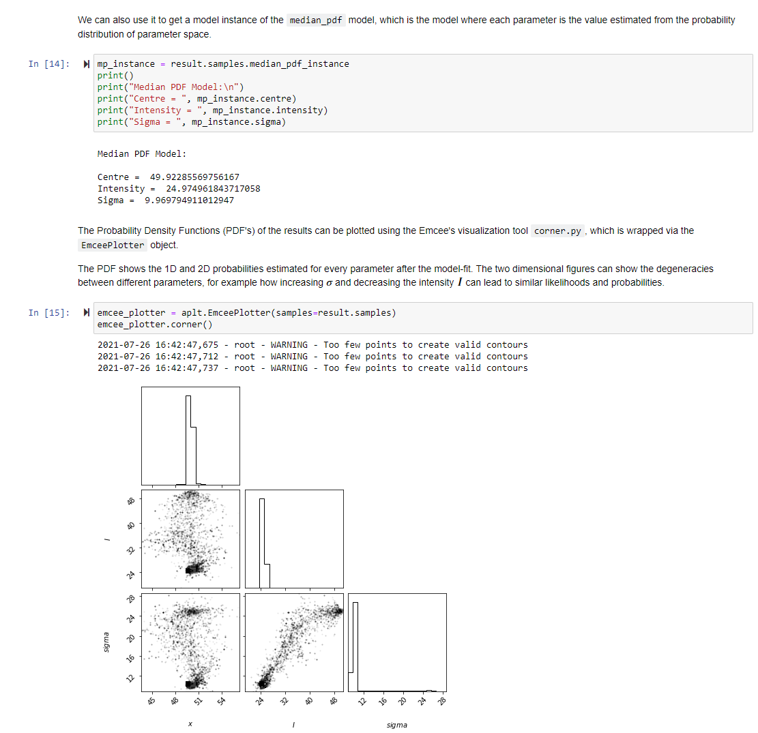
HowToFit
Teach anyone how to compose and fit a probabilistic model with PyAutoFit.

Slide 29
Cosmology: Strong Gravitational Lensing

Slide 30
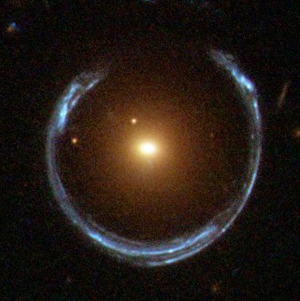
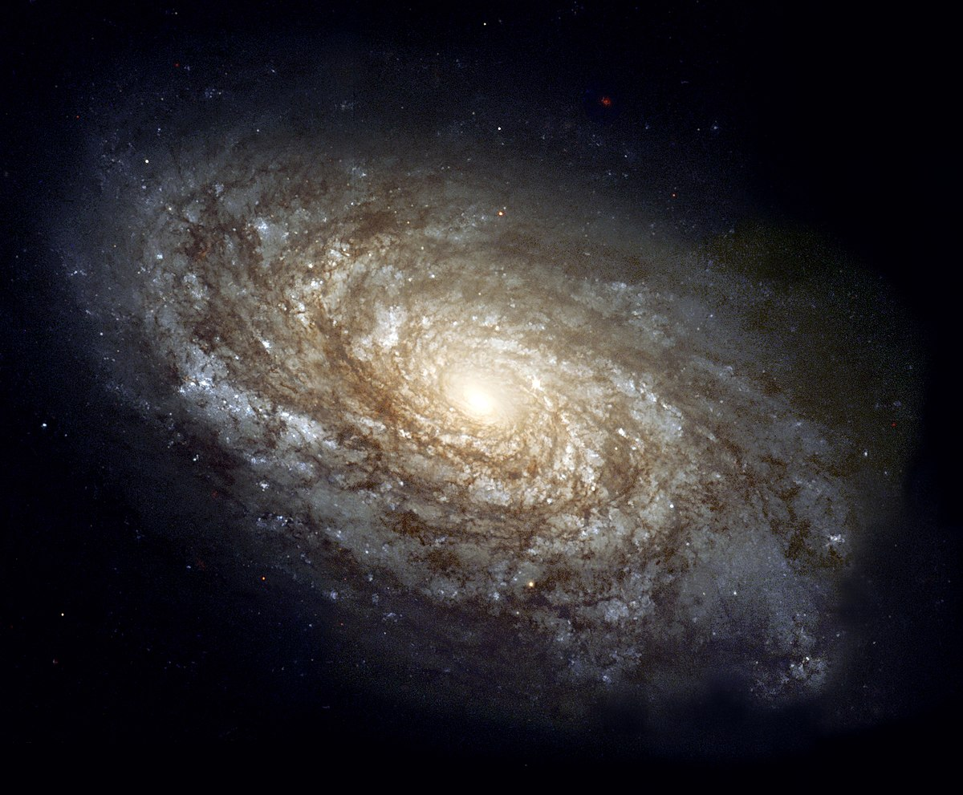
Strong Gravitational Lensing
“Normal” Galaxy: Strong Gravitational Lens:

Slide 31
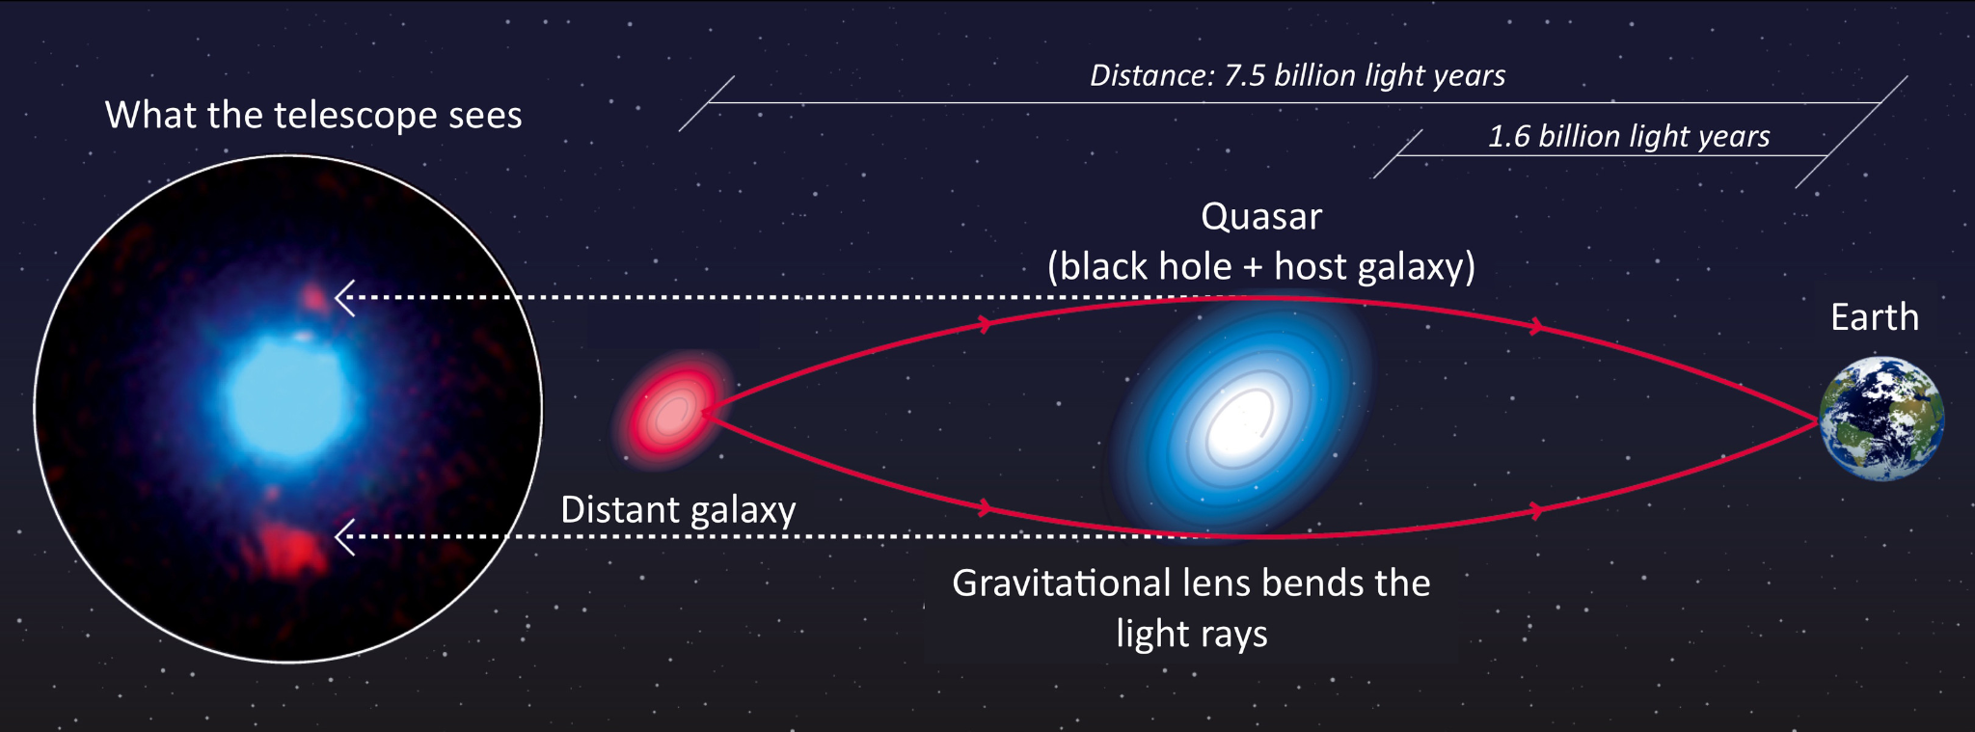
Strong Gravitational Lensing

Slide 32
PyAutoFit: Model Composition

Slide 33
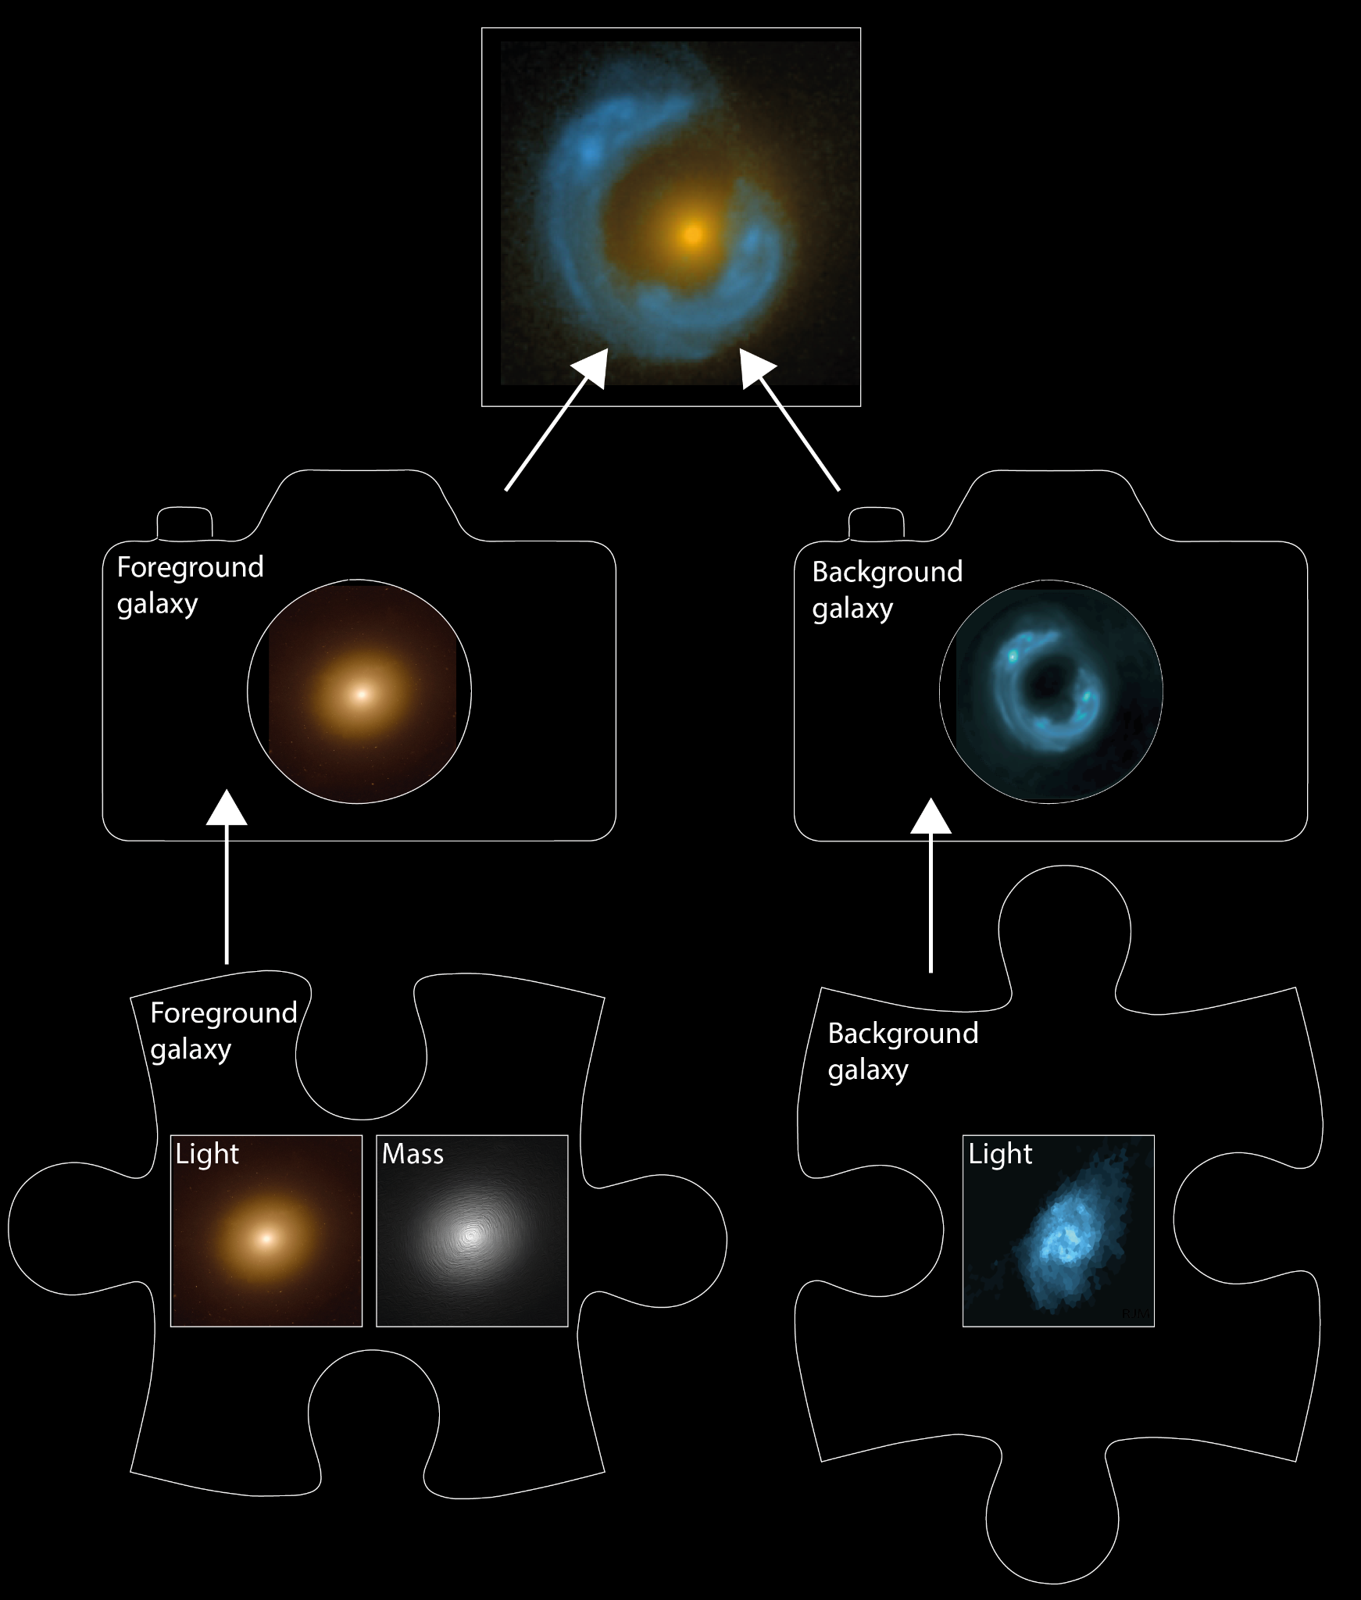
Model Composition
Break strong lens system into different model components:
Lens Galaxy: Light + Mass
Source Galaxy: Light

Slide 34
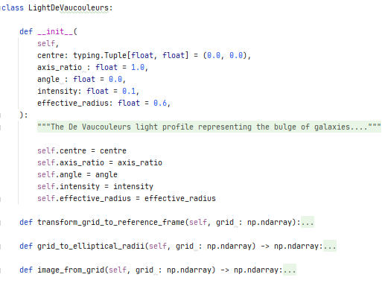
Light and Mass Profile classes
Light Profile:
Write the model components of the problem as Python classes using the same API shown previously.
Note how the model specific calculations of this problem are functions of the classes.

Slide 35
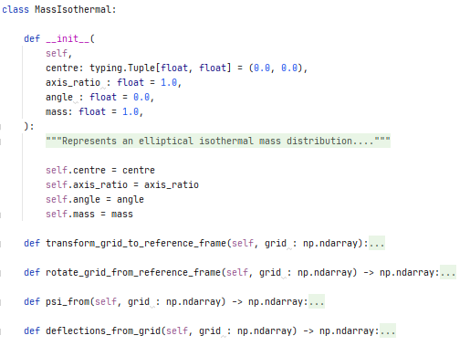
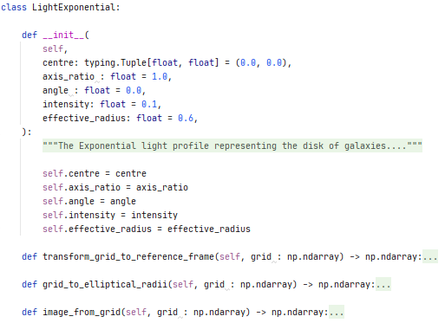
Light and Mass Profile classes
Mass Profile: Light Profile:

Slide 36
Model Composition
Break strong lens system into different model components:
Lens Galaxy: Light + Mass
Source Galaxy: Light

Slide 37
Python Classes
The use of Python Classes to define the has a crucial additional benefit.
It allows for multi-level model composition.
Core for PyAutoFit’s graphical modeling and hierarchical modeling functionality.

Slide 38
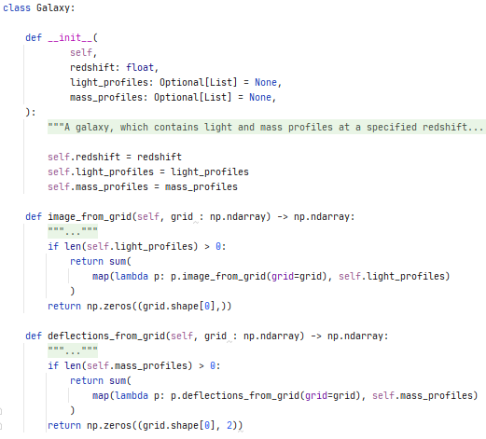
Galaxy Class
Combine the mass and light profiles at a specific redshift to make the lens galaxy and source galaxy.
Note how the image_from_grid and deflections_from_grid methods are included, which use the methods of the individual light and mass profiles.
Redshift = Distance from us in the Universe.

Slide 39
Model Composition
Break strong lens system into different model components:
Lens Galaxy: Light + Mass
Source Galaxy: Light

Slide 40
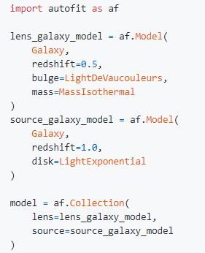
Composing the Model
Scans every light and mass profile to determine this model has 16 free parameters that the non-linear search fits.
A user can easily extend the model with more light profiles, mass profiles, etc.
This is the API a user of your model-fitting software is greeted with!

Slide 41
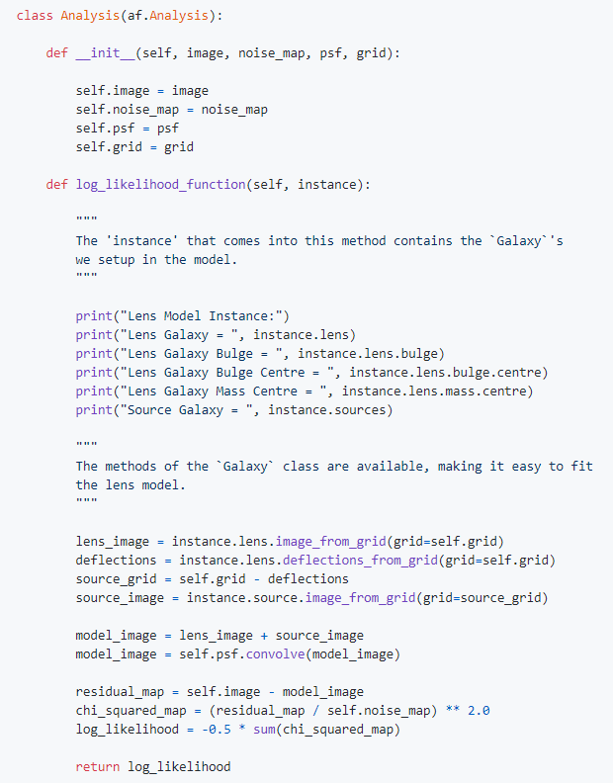
Writing the Analysis
By using Python classes as the model components, this means we can write a concise likelihood function.
Cleanly separate the model-specific code (e.g. light profiles, mass profiles, lensing) from the model-fitting code.
Easy to extend and customize the Analysis class for bespoke model-fitting.

Slide 42
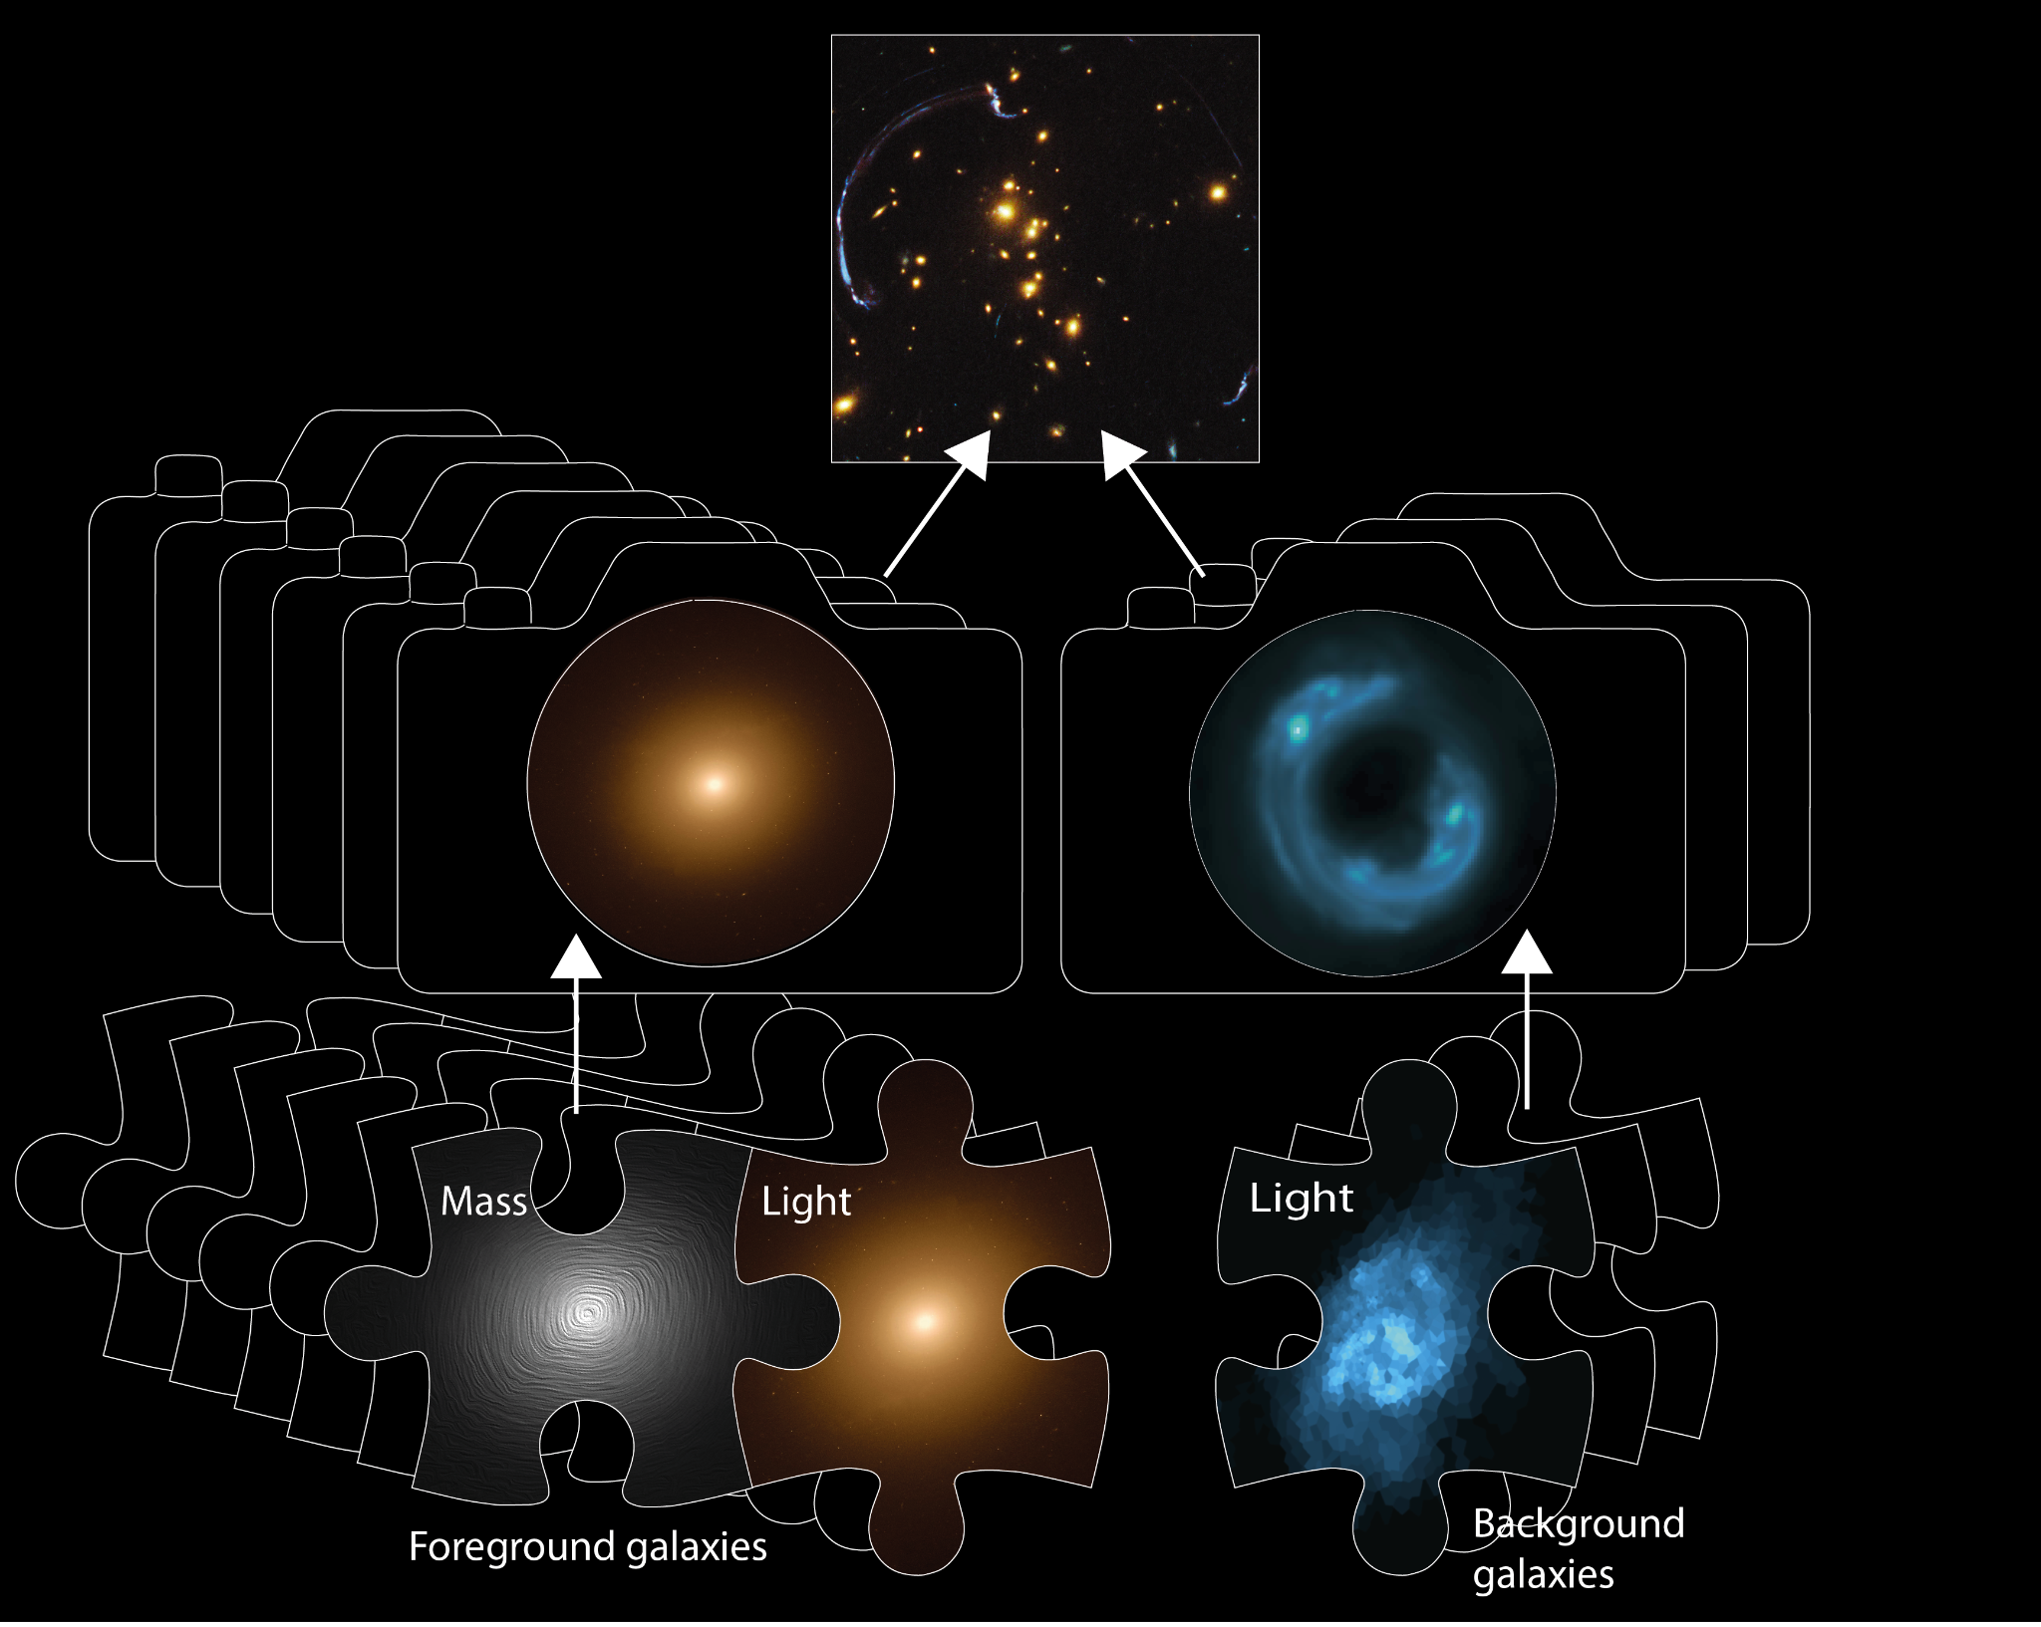
Model Composition
Straightforward for complex models to be composed and fitted in a scalable and streamlined way:
Easy to extend model galaxies with many light and mass profiles.
Or extend the model with many more galaxies.

Slide 43
PyAutoLens: Open Source Strong Gravitational Lensing
All code publically available (pip / conda), object oriented design, extensive documentation.
GitHub: https://github.com/Jammy2211/PyAutoLens Readthedocs: https://pyautolens.readthedocs.io/en/latest/ JOSS paper: https://joss.theoj.org/papers/10.21105/joss.02825
The HowToLens Jupyter notebook lectures teach strong lens modeling to beginners (pitched at undergrads and above)!

Slide 44
PyAutoFit: Advanced
Features

Slide 45
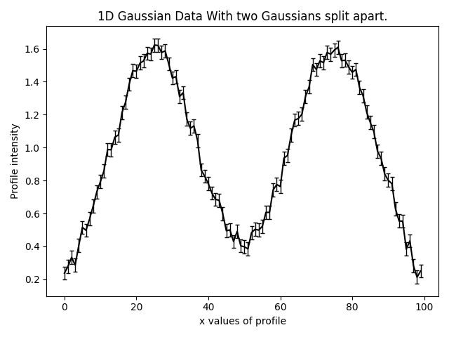
Search Chaining
Break a model-fit into a chained sequence of searches:

Slide 46
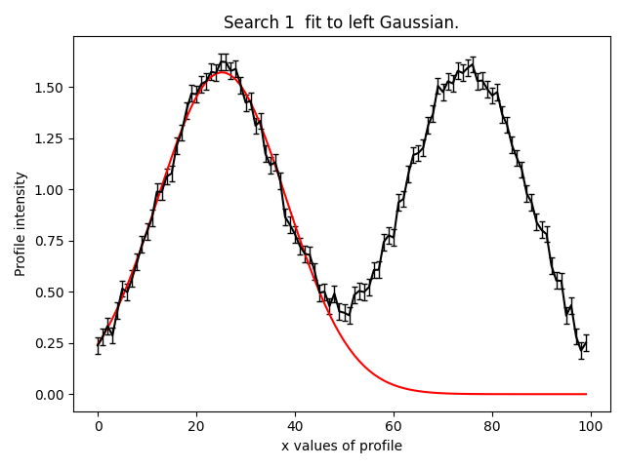
Search Chaining
Break a model-fit into a chained sequence of searches:
Search 1: fit model to left Gaussian with fast non-linear search.

Slide 47
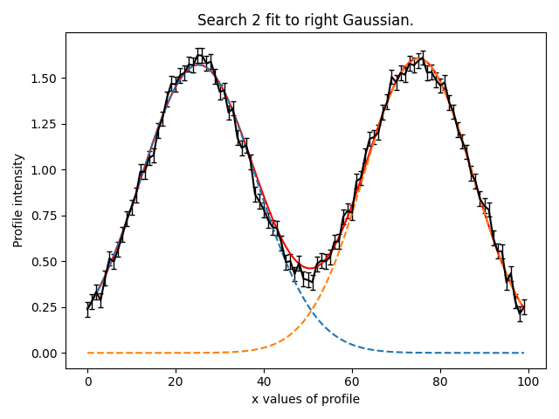
Search Chaining
Break a model-fit into a chained sequence of searches:
Search 1: fit model to left Gaussian with fast non-linear search.
Search 2: fit model to right Gaussian with fast non-linear search and result of search 1.

Slide 48
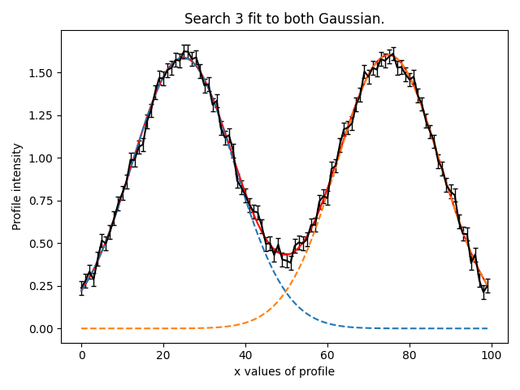
Search Chaining
Break a model-fit into a chained sequence of searches:
Search 1: fit model to left Gaussian with fast non-linear search.
Search 2: fit model to right Gaussian with fast non-linear search and result of search 1.
Search 3: Fit both Gaussians simultaneously with thorough non-linear search and a parameter space starting point inferred from first two searches.

Slide 49
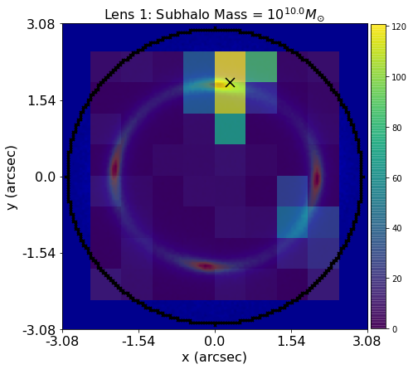
Grid Search of Non-linear Searches
Break a model-fit into a grid search of searches:
Support for massively parallel fits.
Database provides tools for analysing results efficiently.

Slide 50
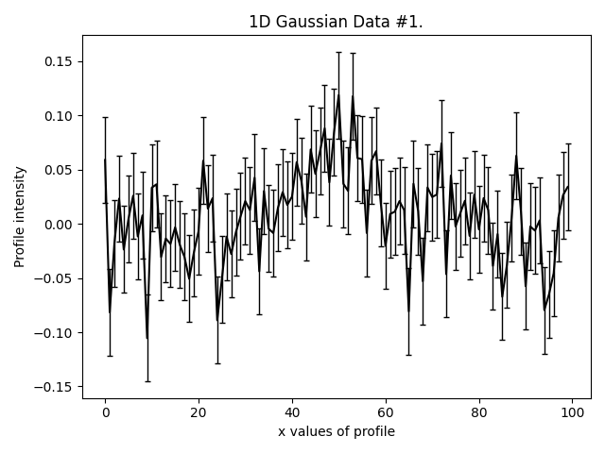
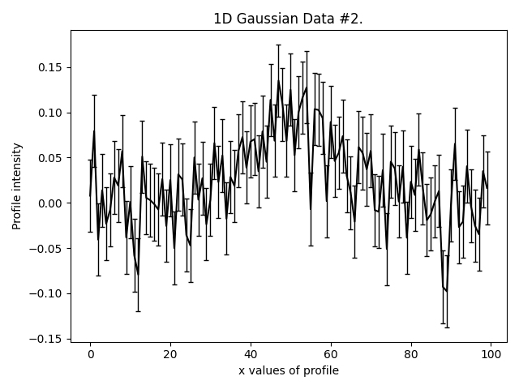

Graphical and Hierarchical Models
Compose multi-level models for fitting many datasets:
Simple example of fitting three low signal to noise Gaussians simultaneously.
Can assume all three Gaussians have same centre, but different intensity / sigma.

Slide 51
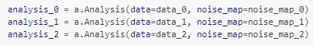
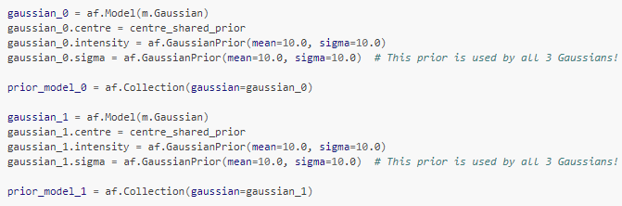
Graphical and Hierarchical Models
Can set up unique Analysis class, which will pair every dataset with components of the multi-level model:
Model is built out of individual model components like before.

Slide 52
PyAutoFit: Customization

Slide 53
Python Classes
The use of Python Classes to define the model, analysis and non-linear searches has downsides relative to other PPLs:
It is a less concise interface.
It requires a basic understanding of Python classes and object oriented programming (albeit good documentation can alleviate this).
The benefit is it provides a far more customizable model-fitting experience.

Slide 54
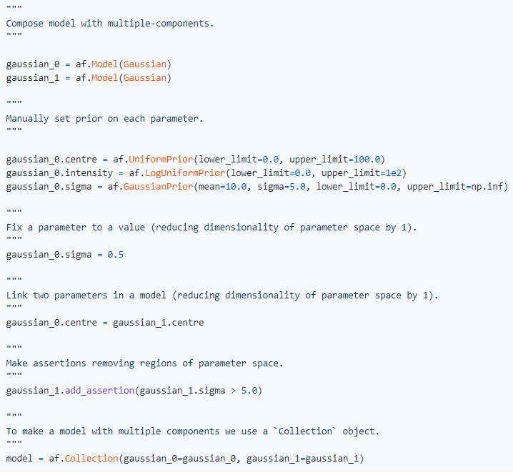
Customizing the Model
Full customization of the model parameterization, priors and valid regions of parameter space.
Default priors can be specified in easy to set up configuration files, so a new user does not need to ‘think’ about them.

Slide 55
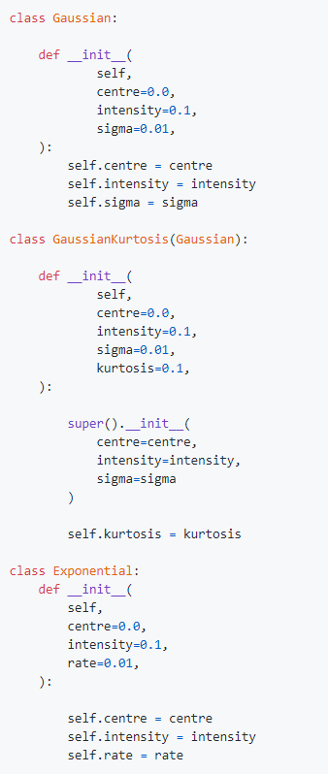
Customizing the Model
Full customization of the model parameterization, priors and valid regions of parameter space.
Straightforward to add many different model-components via inheritance.
Composition makes this concise and scalable.

Slide 56
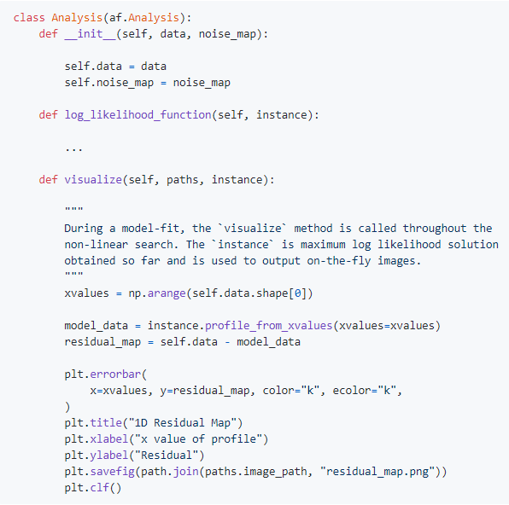
Customizing the Analysis
The Analysis class can be extended or provide model-specific on-the-fly visualization of the model-fit so far.
Uses the maximum likelihood model of the search so far.
For long model-fits can inform you if the fitting has gone wrong early.

Slide 57
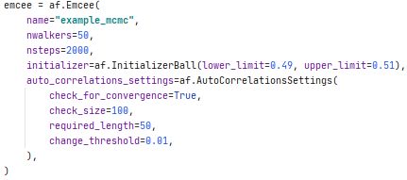
Customizing the Search
PyAutoFit supports many non-linear searches (MCMC, nested sampling, optimizers, etc.).
Full customization of their settings.
Defaults to configuration file values if not specified.

Slide 58
PyAutoFit: Features

Slide 59
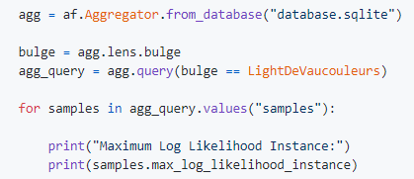
Database
Results of many model fits are output in an sqlite relational database:
Allocated a unique identifier based on the model-fit, such that you can trivially fit many models.
Database supports advanced queries (e.g. find all results, where this parameter is in this range).
Results use memory-light Python generators.
You can therefore fit (very) large datasets on a HPC and access the results efficiently via a Jupyter notebook.

Slide 60
Advanced Modeling Tools
Search Grid Search: Massively parallel grid searches of non-linear searches.
Search Chaining: Write highly customizable model-fitting pipelines that chain together multiple non-linear searches.
Sensitivity Mapping: Simulate and fit many datasets to determine when a more complex model would be accepted via model comparison.
Graphical / Hierarchical Models: Fit for global trends in large datasets by composing and fitting graphical models.

